Slide 1
CSN-503 Project
Secure File Transfer over LAN
Group no-1
Team members:
1. Aayushi Jain - 20535001
2. Ayush Aggarwal - 20535008
3. Km Khushbu - 20535014
4. Mohammad Nazim - 20535017
5. Preeti - 20535021
6. Pushpamanjari - 20535022
7. Tanmay Narayan Jawkhed - 20535031
Submitted to:
Professor Durga Toshniwal

Slide 2
Team member’s contribution:
Aayushi Jain (20535001) :
Sender module
Connection establishment
sending encrypted file
Ayush Aggarwal (20535008):
Network analysis.
Packet capturing using Wireshark.
Km Khushbu (20535014):
File Service server Module.
Mohammad Nazim (20535017):
GUI.
Framework design.
Preeti (20535021):
Encrypting and Decrypting file using AES .
Pushpamanjari (20535022):
Encrypting and Decrypting AES key using
RSA algorithm.
Tanmay Narayan Jawkhede (20535031):
Receiver module
Connection establishment
Receiver permission verification
Passcode verification
Accepting encrypted file and Store on Receiver End in its Original form.

Slide 3
Functionalities:
File service server:
Helps in monitoring all the active receivers in LAN(receiving or waiting to receive files).
Secure file transfer Application:
Interactive UI
Can act as server/receiver at the same time.
Multiple senders can send file to single receiver.
Files is encrypted before sending.
Live status updates of ongoing activity.
No need to remember IP address of receiver, we can register active user with their name.
Sender requires receiver’s permission before sending file(receiver uses a passcode).
One file can be transferred at a time.

Slide 4

Walkthrough

Slide 5


Slide 6
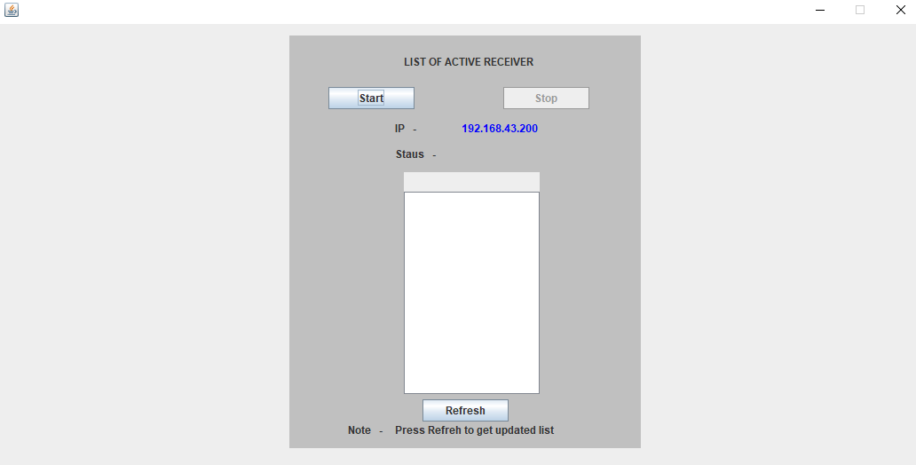
File Service Server
Main Motivation of using File Service server Functionality is to find the list of Active Receiver.
Structure:

Slide 7
Main Functionality of File Service Server:
File Service server maintains a list of Active receiver (for this it is using ‘list’ variable). And provides list to sender whenever sender request to file server.
While registering, Receiver provides its ‘name’ , ‘IP address’ & ‘status’
Server check status and accordingly perform Action
Functionality of start button:
Change status of server to “Started”
Create Socket for Server so that it can receive request and accept request to and from Client(Sender or receiver)
server = new ServerSocket (port number)
Functionality of stop button:
It will remove all the entries from list and close the server.
list.clear()
server.close()

Slide 8
Functionality of refresh button:
It updates the list of active receiver whenever receiver connect and disconnect.
If(status.equalsIgnoreCase(“Initialize”)) list.add(sendData.getName() + ”:” + sendData.getIP() )
If (status.equalsIgnoreCase(“getActiveRecvr”))
SEND replyData = new SEND()
replyData.setActiveRcvr(list)
out = new ObjectOutputStream(socket.getOutputStream())
out.writeObject(replyData)
out.flush()
If(status.equalsIgnoreCase(“stopped”))
list.remove(sendData.getIP())

Slide 9
Connect and Send Data- Sender
Requests receiver for the connection.
Sends the data if receiver accepts its request.
Requests sent with status “NEW”
Sender
Receiver
Receiver sends the passcode and Status
Sends the data to the receiver if status received is SUCCESS

Slide 10
Connect and Send Data- Sender
To connect with the receiver : Object of Socket class is created and then object of OutputObjectStream class is created(out).
Then using writeObject() of class OutputObjectStream, we’ll
pass it to the receiver. Then call out.flush().
2. Get response from the receiver :Create an object of ObjectInputStream Class . Read the data sent by the receiver using readObject() of ObjectInputStream class.
3. Send the data to the receiver: Object of FileInputStream Class will be create which will read the file.Then send the encrypted data to the receiver.

Slide 11
Connect and Send Data- Sender
To connect with the receiver.
Socket socket = new Socket(textField.getText().trim(), 9199);
ObjectOutputStream out = new ObjectOutputStream(socket.getOutputStream());
SEND sendData = new SEND();
out.writeObject(sendData);
out.flush();
Get Response from the receiver
ObjectInputStream in = new ObjectInputStream(socket.getInputStream());
SEND recvData=(SEND) in.readObject();
String status=recvData.getStatus();
if(status.equals("SUCCESS"))
{
String rcvdPasscode=recvData.getPasscode();
sendButton.setEnabled(true);
}
Send Data to the receiver if status is success.
FileInputStream fis = new FileInputStream(textField_1.getText().trim());
FileOutputStream fos = new FileOutputStream("/SEND/"+textField.getText().trim()+"encrypted-"+filename);
CipherOutputStream cos = new CipherOutputStream(fos, cipher);
int b;
while((b = fis.read(bytes)) != -1) {
cos.write(bytes, 0,b );
}
cos.flush();

Slide 12
AES
AES (Advanced Encryption Standard) is a strong symmetric encryption algorithm. A secret key is used for the both encryption and decryption of data. Only someone who has access to the same secret key can decrypt data.
block cipher implementation
The block size used by AES is 128 bits
128/192/256-bit keys
Stronger and faster than Triple-DES

Slide 13
Java provides a number of helper classes for AES encryption such as
Cipher (for encryption/decryption)
SecretKey (represents the shared secret key)
KeyGenerator (generates the shared secret key).

Slide 14
Generate Key
KeyGenerator generator = KeyGenerator.getInstance("AES");
generator.init(256);
SecretKey secretAesKey = generator.generateKey();
Encryption
Cipher cipher = Cipher.getInstance("AES");
cipher.init(Cipher.ENCRYPT_MODE, secKey); //client scrt key
CipherOutputStream cos = new CipherOutputStream(fos,cipher);
int b;
While((b=fis.read(byte))!= -1)
{
cos.write(bytes, 0, b);
}
cos.close();

Slide 15
Decryption
Cipher cipher1 = Cipher.getInstance("AES");
cipher1.init(Cipher.DECRYPT_MODE, secretAesKey);
byte[] encryptedBytes =new byte[(int).file.length()];
Fis = new FileInputStream(file);
Fis.read(encryptedBytes);
Int b1;
While((b1=cis.read(encryptedBytes))!= -1)
{
fos1.writes(encryptedBytes, 0, b1);
}

Slide 16
RSA
RSA (Rivest–Shamir–Adleman) is an algorithm used by modern computers to encrypt and decrypt messages. It is an asymmetric cryptographic algorithm.
The integers used by this method are sufficiently large making it difficult to solve.
Purpose:
To encrypt the shared (secret)key used for encrypting the file at sender’s end.
To decrypt the same shared (secret)key used for decrypting the file at reciever’s end.

Slide 17
Key generation
final KeyPair pair=getPublicKey();
prikey=pair.getPrivate();
publicKeytosend=pair.getPublic();
private KeyPair getPublicKey() throws NoSuchAlgorithmException {
KeyPairGenerator generator = KeyPairGenerator.getInstance("RSA");
generator.initialize(2048, new SecureRandom());
KeyPair pair = generator.generateKeyPair();
return pair;
}

Slide 18
Encryption
String senderAesKey = encrypt(encodedKey, rcvrPublicRsaKey);
public String encrypt(String plainText, PublicKey publicKey) throws Exception {
Cipher encryptCipher = Cipher.getInstance("RSA");
encryptCipher.init(Cipher.ENCRYPT_MODE, publicKey);
byte[] cipherText = encryptCipher.doFinal(plainText.getBytes(StandardCharsets.UTF_8.name()));
return Base64.getEncoder().encodeToString(cipherText);
}
Decryption
String senderAesKeyDcrypted = decrypt(senderAesKeyEncrypted, prikey);
public String decrypt(String cipherText, PrivateKey privateKey) throws Exception {
byte[] bytes = Base64.getDecoder().decode(cipherText);
Cipher decriptCipher = Cipher.getInstance("RSA");
decriptCipher.init(Cipher.DECRYPT_MODE, privateKey);
return new String(decriptCipher.doFinal(bytes), StandardCharsets.UTF_8.name());
}

Slide 19
Receiver
Receiver Having three Functionality
1.Register them self on file service server and make them
available to receive file from local network sender.
2 .Accept/Reject Sender Request ,generate and send
passcode and public key to sender accordingly.
3 . Accept and decrypt file or simply Reject senders file,

Slide 20
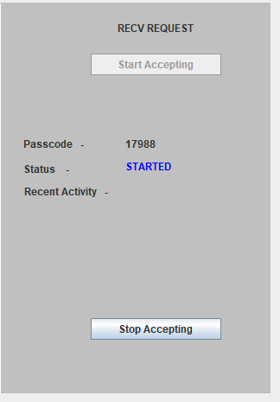
1. Registration
Receiver have to click on “start accepting” before accepting any request from sender.
RECEIVER
STATUS=“INITILIZATION”
FILE SERVICE SERVER
IP+RCVR NAME
STATUS=“SUCCESS”
socket = new Socket(FILE SERVICE SERVER IP, PORT NUMBER);
ObjectOutputStream out1 = new ObjectOutputStream(socket.getOutputStream());
SEND sendData = new SEND();
sendData.setStatus("Initialize");
sendData.setIP(“RCVR -IP”);
sendData.setName(“RCVR NAME”)
out1.writeObject(sendData);
ServerSocket server = new ServerSocket(PORTNUMBER);
Socket s = server.accept();

Slide 21
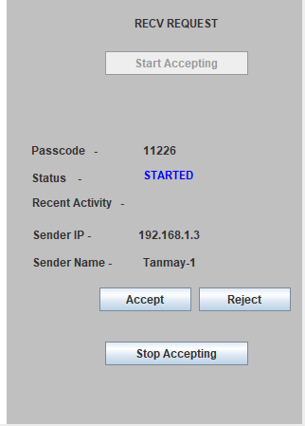
2. Accept/Reject Sender’s Request
Sender Request to Receiver Before sending any file
SENDER
STATUS=“NEW”
RECEIVER
IP +SENDER NAME
STATUS=“SUCCESS”
PASSCODE + RECVR PUBLIC KEY
Socket s = server.accept();
ObjectInputStream in = new ObjectInputStream
(s.getInputStream());
rcvdObject=in.readObject();
ObjectOutputStream out1 = new ObjectOutputStream(s.getOutputStream());
SEND rplyObj= new SEND();
rplyObj.setPublicKey(publicKeytosend);
rplyObj.setpassCode(passCodetoSend);
rplyObj.setStatus(statustoSend);
out1.writeObject(rplyObj);

Slide 22
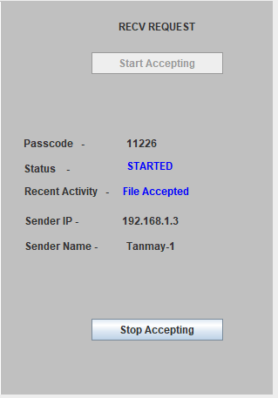
3. Accept and Decrypt File
Sender Request to Receiver Before sending any file
SENDER
STATUS=“FILE”
RECEIVER
FILE+PASSCODE+
SENDER’S AES KEY
(ENCRYPTED-FORM)
STATUS=“SUCCESS”
Files.createDirectories(Paths.get("/RECEIVED/"+sendData.getIP()+"/"+date));
FileOutputStream fos1 = new FileOutputStream("/RECEIVED/"+sendData.getIP()+"/"+date+"/"+sendData.getFileName())
fos1.write(decryptedBytes, offset,length );

Slide 23
Wireshark
Wireshark is a network packet analyzer which tries to capture network packets and tries to display the packet data as detailed as possible.
Used for troubleshooting , and monitoring of network and see all details of packet through the network
Open source software
Available for many types of OS with GUI environment which provide user friendly interface
Used by-
network administrators to troubleshoot network problems
network security engineers to examine security problems
developers to debug protocol implementations

Slide 24
Features
• Available for UNIX and Windows.
• Capture live packet data from a network interface.
• Display packets with very detailed protocol information.
• Open and Save packet data captured.
• Filter packets on many criteria.
• Colorize packet display based on filters.
• Create various statistics.

Slide 25
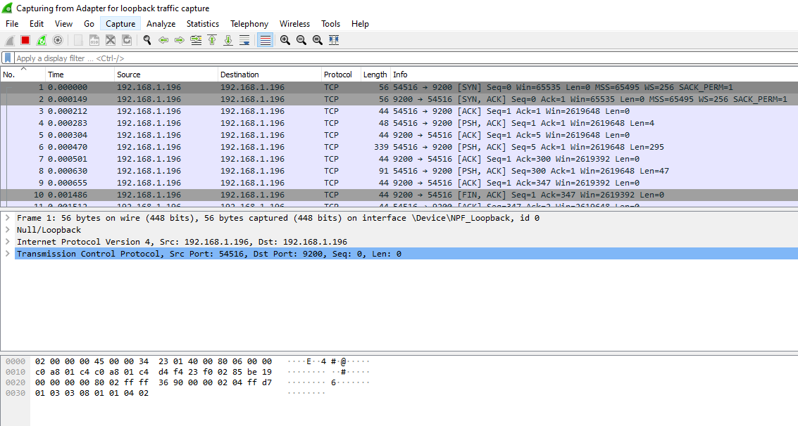
TCP 3 Way Handshake

Slide 26
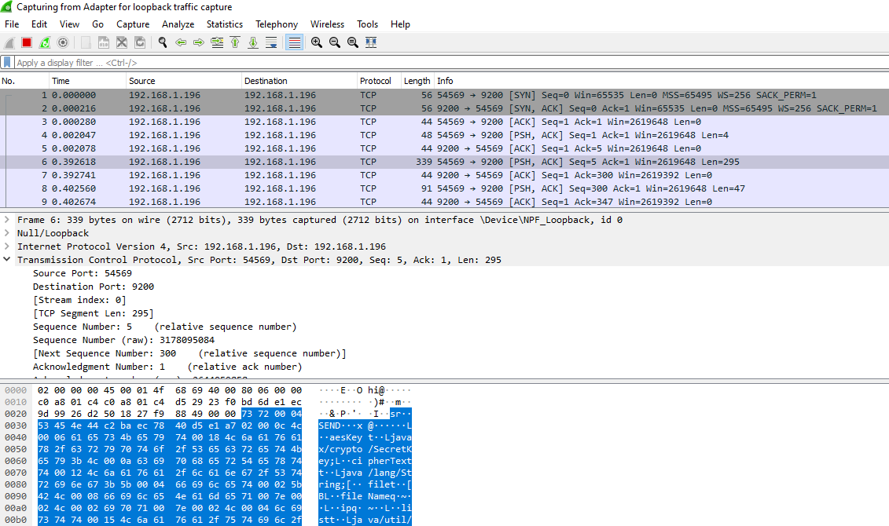
Packet Details

Slide 27
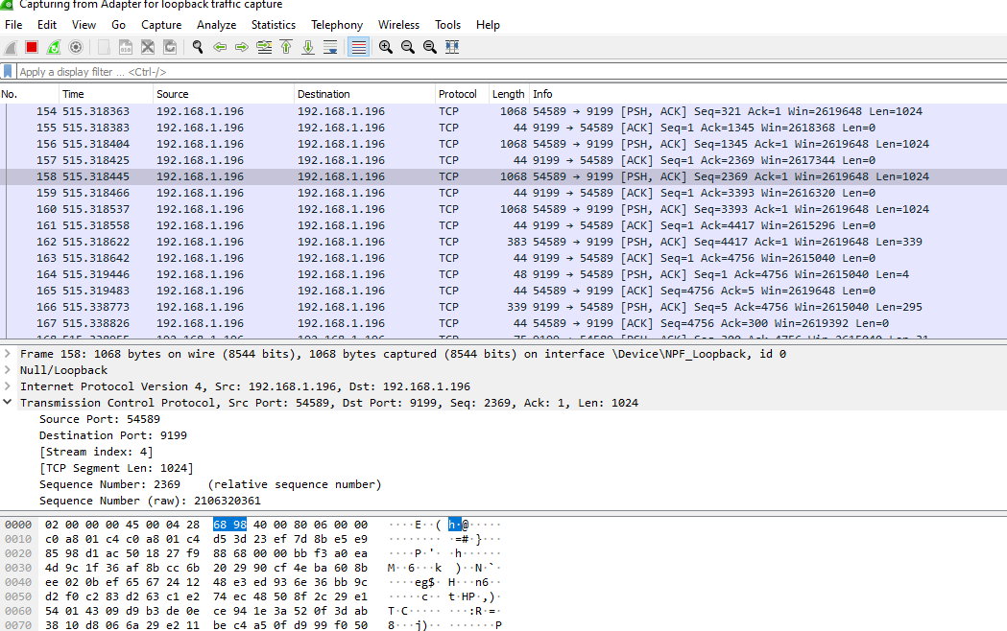
Secure Data Transfer

Slide 28
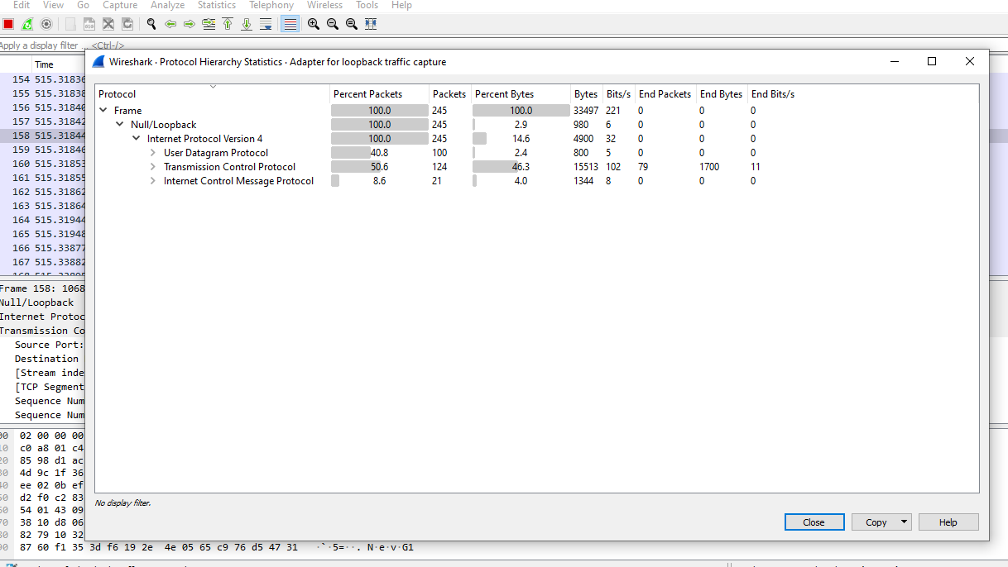
Statistics

Slide 29
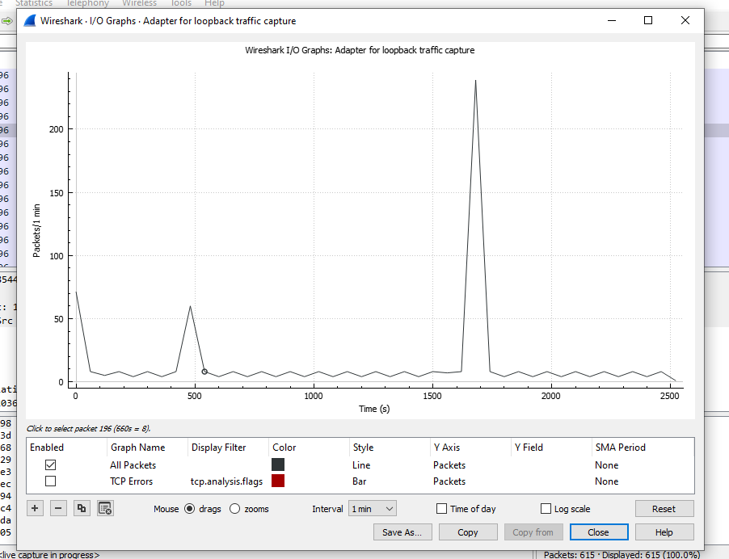
I/O Graph

